Slide 1
Coder Dojo Scratch Series Beyond the Basics Week 5

Slide 2
About Art files
SVG – Scaled Vector Graphics
XML file of math formulas(*) which describe how to draw something
Scale up and down with no loss of quality
‘Touching’ detection easier (maybe)
Bitmap: GIF
Transparent background
Can be animated
Bitmap: PNG- keeps layers alive
Bitmap: JPG- compressed pictures

Slide 3
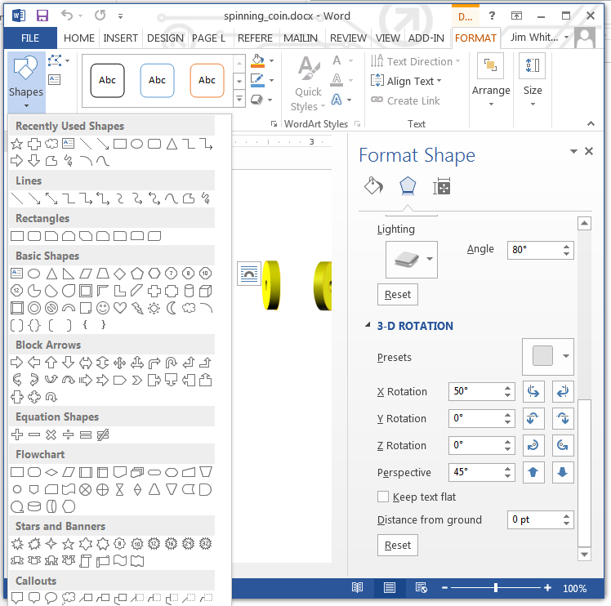
Making 3D Art
MS Word
I used tools that can do 3D
MS Office to craft simple shapes
Adobe Illustrator for the shamrock
I put the images into an editor that could create files with transparent backgrounds
I created animated GIFs using Fireworks, but that was unnecessary
Paint.NET and Inkscape are free and good.
I created a sprite and imported.
Animated GIFs fill all costumes at once
Or, just ‘new costume’ then import

Slide 4
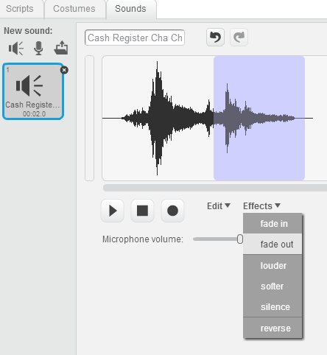
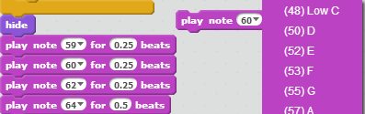
Sounds
You can import sounds
You can do minimal editing of wave files
You can program notes for music

Slide 5
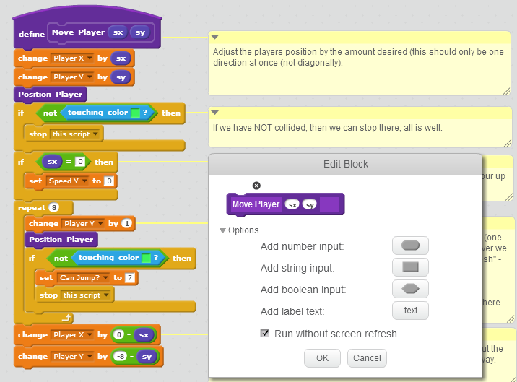
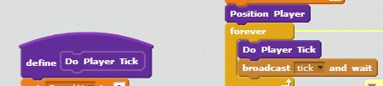
“Platform Magic” in scratch’s projects/19015667
This project uses a code block which tries movement with screen updates off, so that you don’t visually see it banging the objects around
Another thing that’s very advanced is that it has a universal clock it manages, rather than relying on a bunch of forever loops

Slide 6
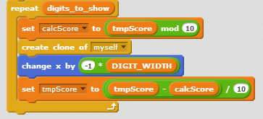
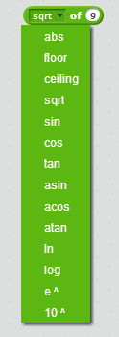
Math Operations beyond + - * and /
Some younger kids might not know that
* is multiply
/ is divide
The ‘mod’ operation calculates remainders.
In typed languages, the operator is %
17 mod 10 = 7 17 % 5 = 2
I use mod to make a pretty scoreboard
There are several ‘hidden’ math operations, also.

